Slide 1
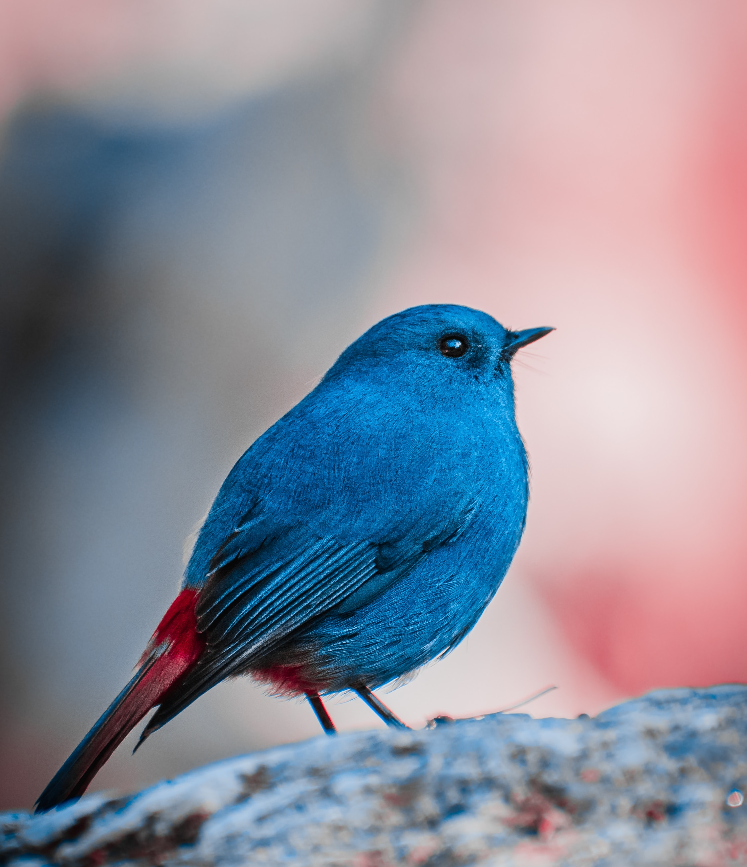
Identification Of Bird Species Using Automation Tool
Submitted by:
Aishwarya MS
Ambika Katta
Gurupriya Reddy
Keerthana S Gowda
Guided by:
Prof. Rose Priyanaka
Computer Science Engineering
Notes:
Line spacing + Page numbers

Slide 2
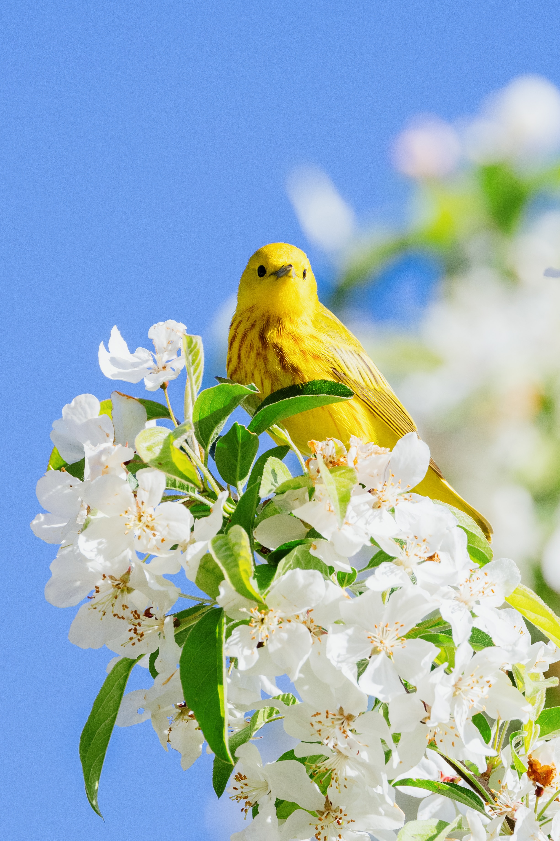
Contents
01 Abstract
02 Introduction
03 Literature Survey
04 Existing System
05 Proposed System
06 Problem Statement
07 Requirements
08 Design
09 Outputs
10 Conclusion

Slide 3
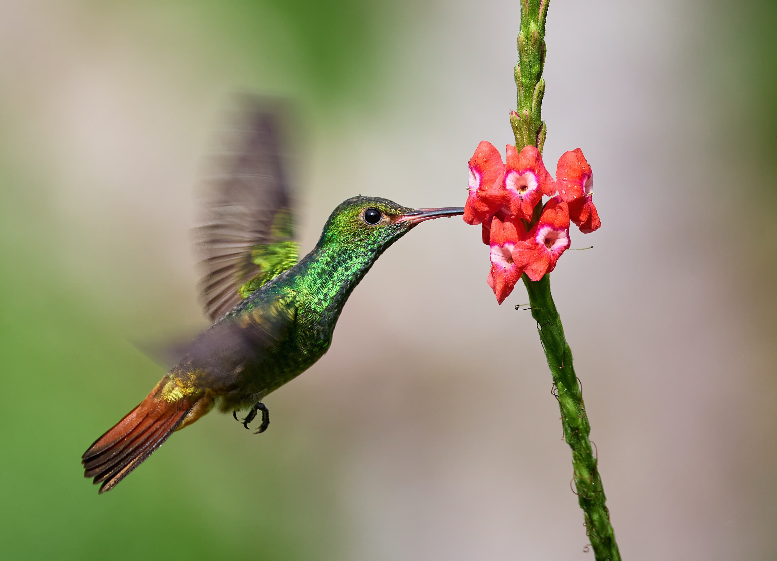
ABSTRACT
01
Bird population is decreasing dramatically. Bird identification system that does not require physical intervention.
Keep track of bird species with the help of automatic detection using machine learning algorithms.
Convolutional Neural Networks are used instead of traditionally used methods such as SVM, Random forest.
The ultimate goal is to identify bird species from a data set containing various bird calls.
The input dataset is preprocessed, such as framing, silence removal, and reconstruction, to create a spectrogram.

Slide 4
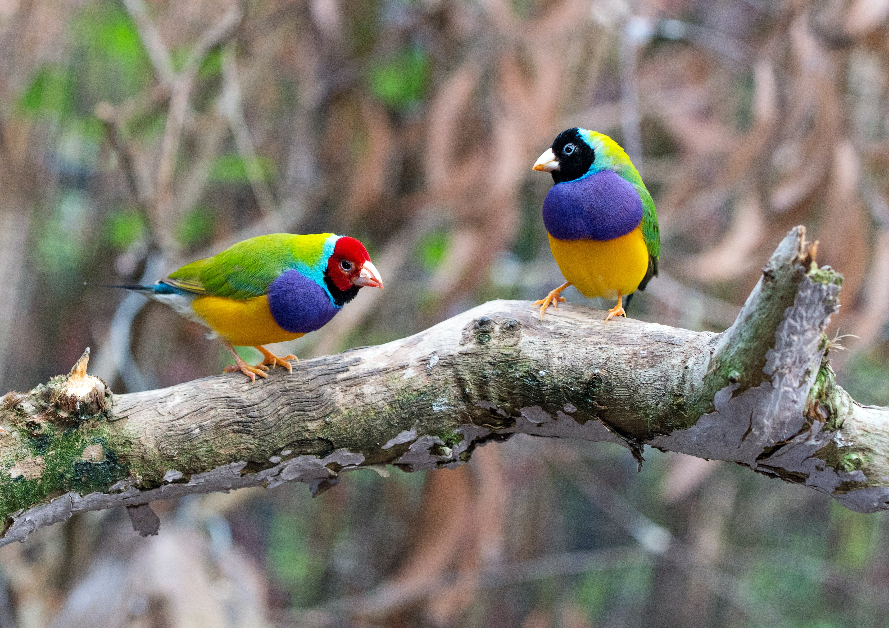
Introduction
02
Human interference and environmental catastrophes threaten 13.5% of bird species.
Monitoring bird species can help control and evaluate the environment, but it is costly and labor-intensive.
A deep learning method using ANN is proposed for automatic bird species identification based on audio recordings.
The method involves recording, pre-processing, extracting, training, and predicting using the proposed algorithm.
The proposed method achieves 100% training accuracy and 97% validation accuracy, outperforming existing models.

Slide 5
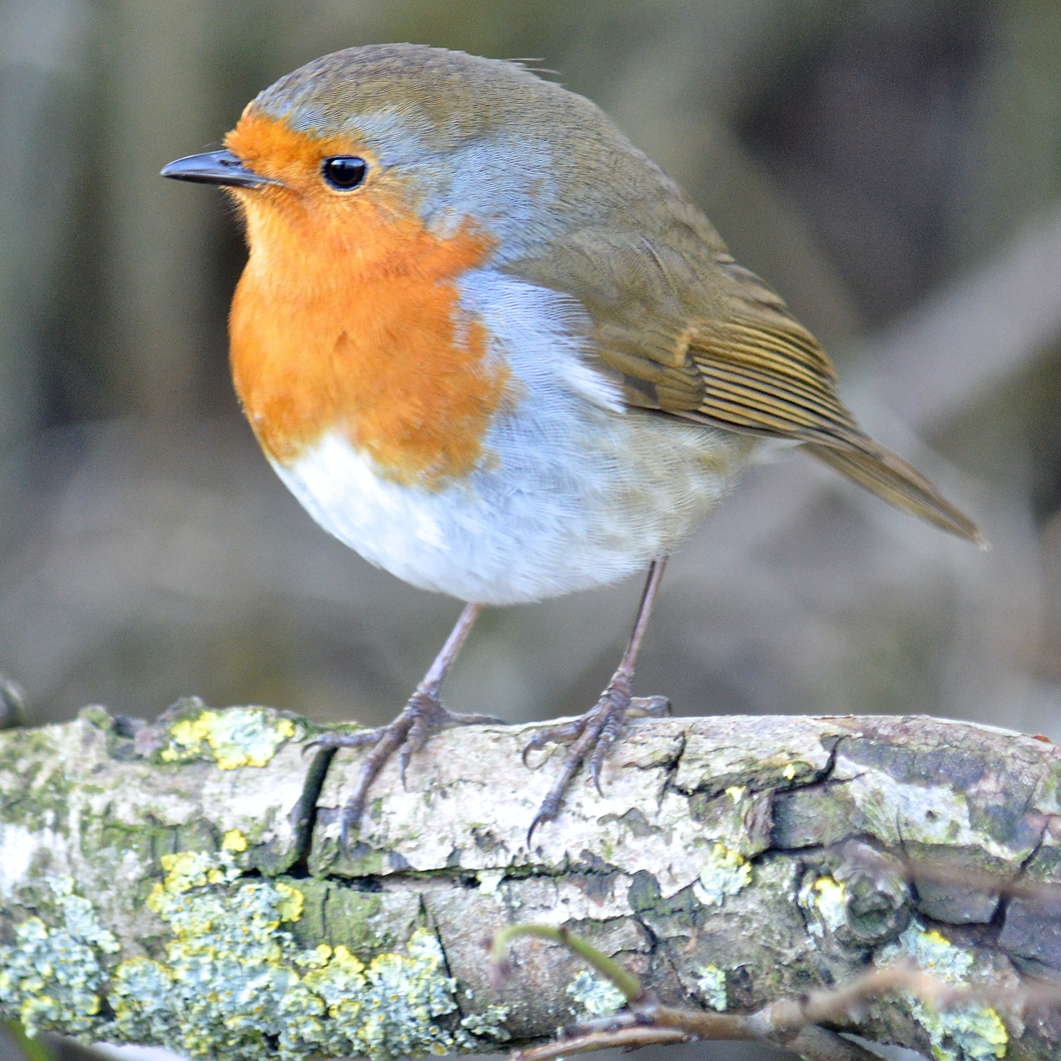
Literature Survey
03
A lightweight CNN framework for speedy image crowd counting accurately estimates headcounts in public places during COVID-19 while consuming less time.
Variants of ELM algorithms have been developed to improve accuracy and optimize classification tasks with less human intervention, addressing the limitations of FFNN in terms of slow computation time and increased gain.
An automatic bird species recognition system has been developed using a two-stage identification process that employs various sound pre-processing techniques to generate spectrograms, which are then input to a convolutional neural network to recognize bird species in real-time.
Bird sound identification using ANN has been proposed, where each bird has a different tone of sounds, and the ANN is used to classify and recognize bird sounds. A GUI has been developed to input audio and identify bird species.
A deep learning-based audio classifier for bird species recognition has been proposed to track the effects of human activities on the environment, recognizing bird species based on audio recordings and providing assistance to ecologists in tracking breeding behavior, biodiversity, and population dynamics.

Slide 6
04 Existing and Proposed System
EXISTING SYSTEM | PROPOSED SYSTEM
The existing system is a time constraint; it takes a long time to analyze the sound of the birds. The existing system usually requires much more data. Lots of training data is required The existing system is also more computationally expensive. The existing system can take several weeks to train the dataset completely from scratch. The amount of computational power needed is also more. | The proposed system requires only lesser time to analyze the sound of the birds. The proposed system can handle with less number of training data also. The proposed system is not more expensive when compared to the existing system models. The proposed system may take only few hours train the dataset completely from scratch which is much lesser than the existing system model. The proposed system requires only less amount of computational power. The proposed system has good fault tolerance. The proposed is also has a good distributed memory.

Slide 7
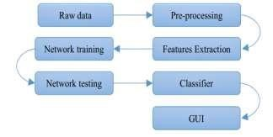
05
PROBLEM STATEMENT
1.Develop an automated system for accurately identifying different bird species from their recorded songs. 2.Distinguishing diverse bird species from their recorded songs is difficult, and expert analysis suggests that bird songs are more effective for species identification than bird sounds. 3.Exchange of information and identification of threats or territory are important for birds through audio expression. 4.A pre-processing technique is required to extract the most relevant segment of the signal and extract features for accurate bird species recognition. 5.The solution involves using machine learning algorithms for accurate bird species recognition.
.

Slide 8
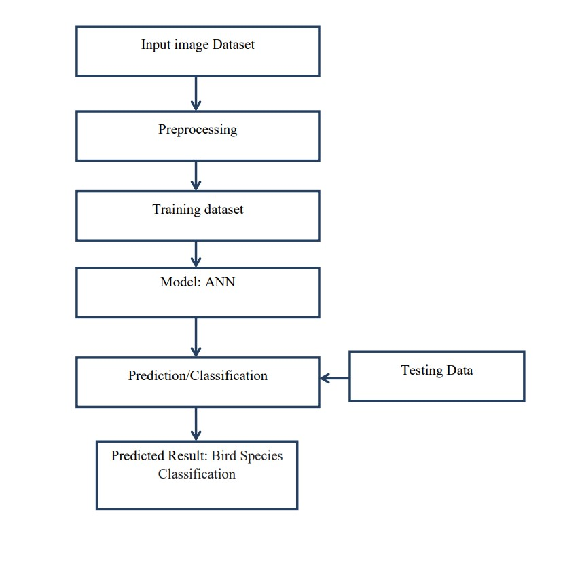
SYSTEM DESIGN
06
Data is collected from respected dataset.
On the dataset, data pre-processing techniques .
such as framing and noise removal are used.
The data is processed using the Convolutional
Neural Network approach.
Model output is displayed on the screen
.
.
.

Slide 9
REQUIREMENTS
07
Hardware
Requirements
System: pentium i3 processor.
Harddisk: 500 GB.
Monitor: 15" led
Input devices: keyboard, mouse
Ram: 4 GB
Software Requirements
Operating system: windows 10
Coding language: python
Web framework: flask

Slide 10
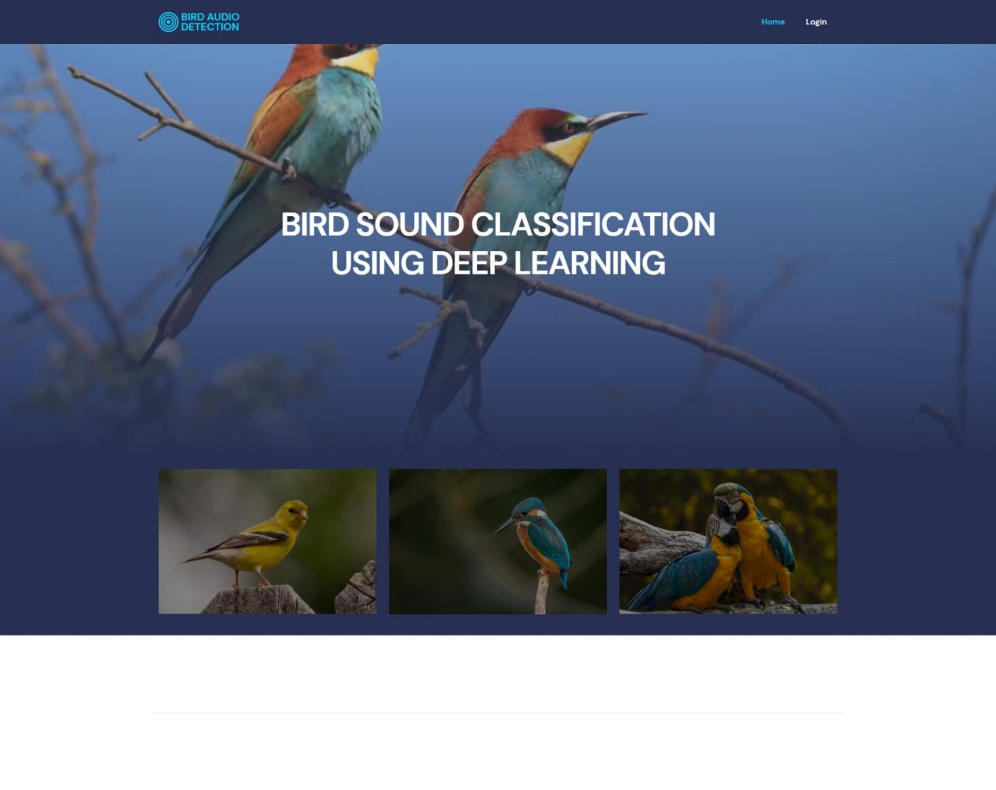
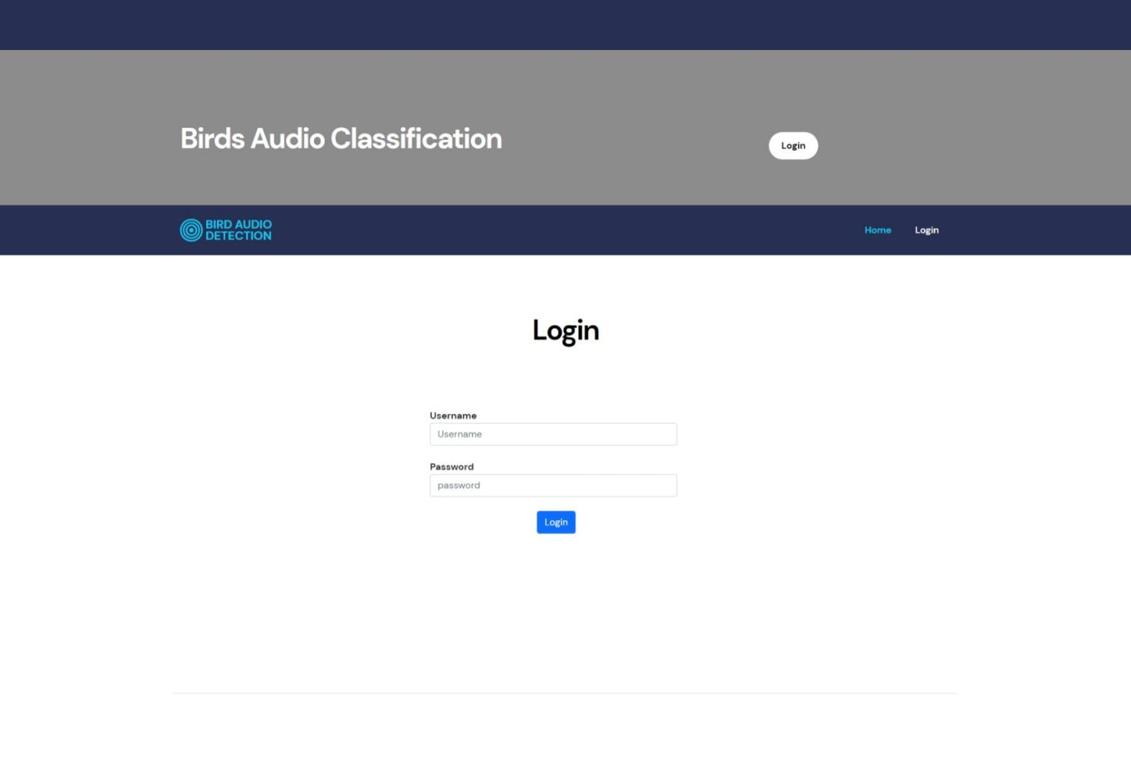
08
OUTPUTS

Slide 11
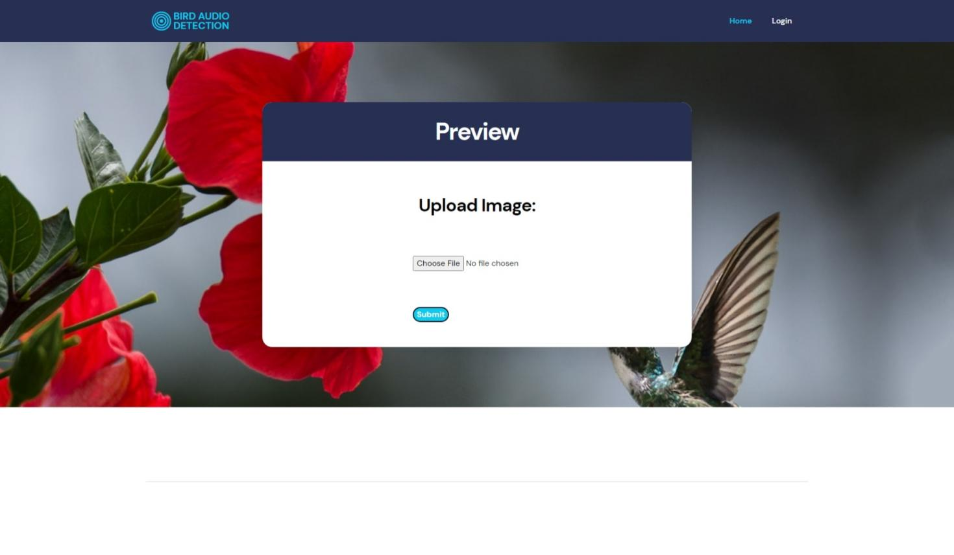
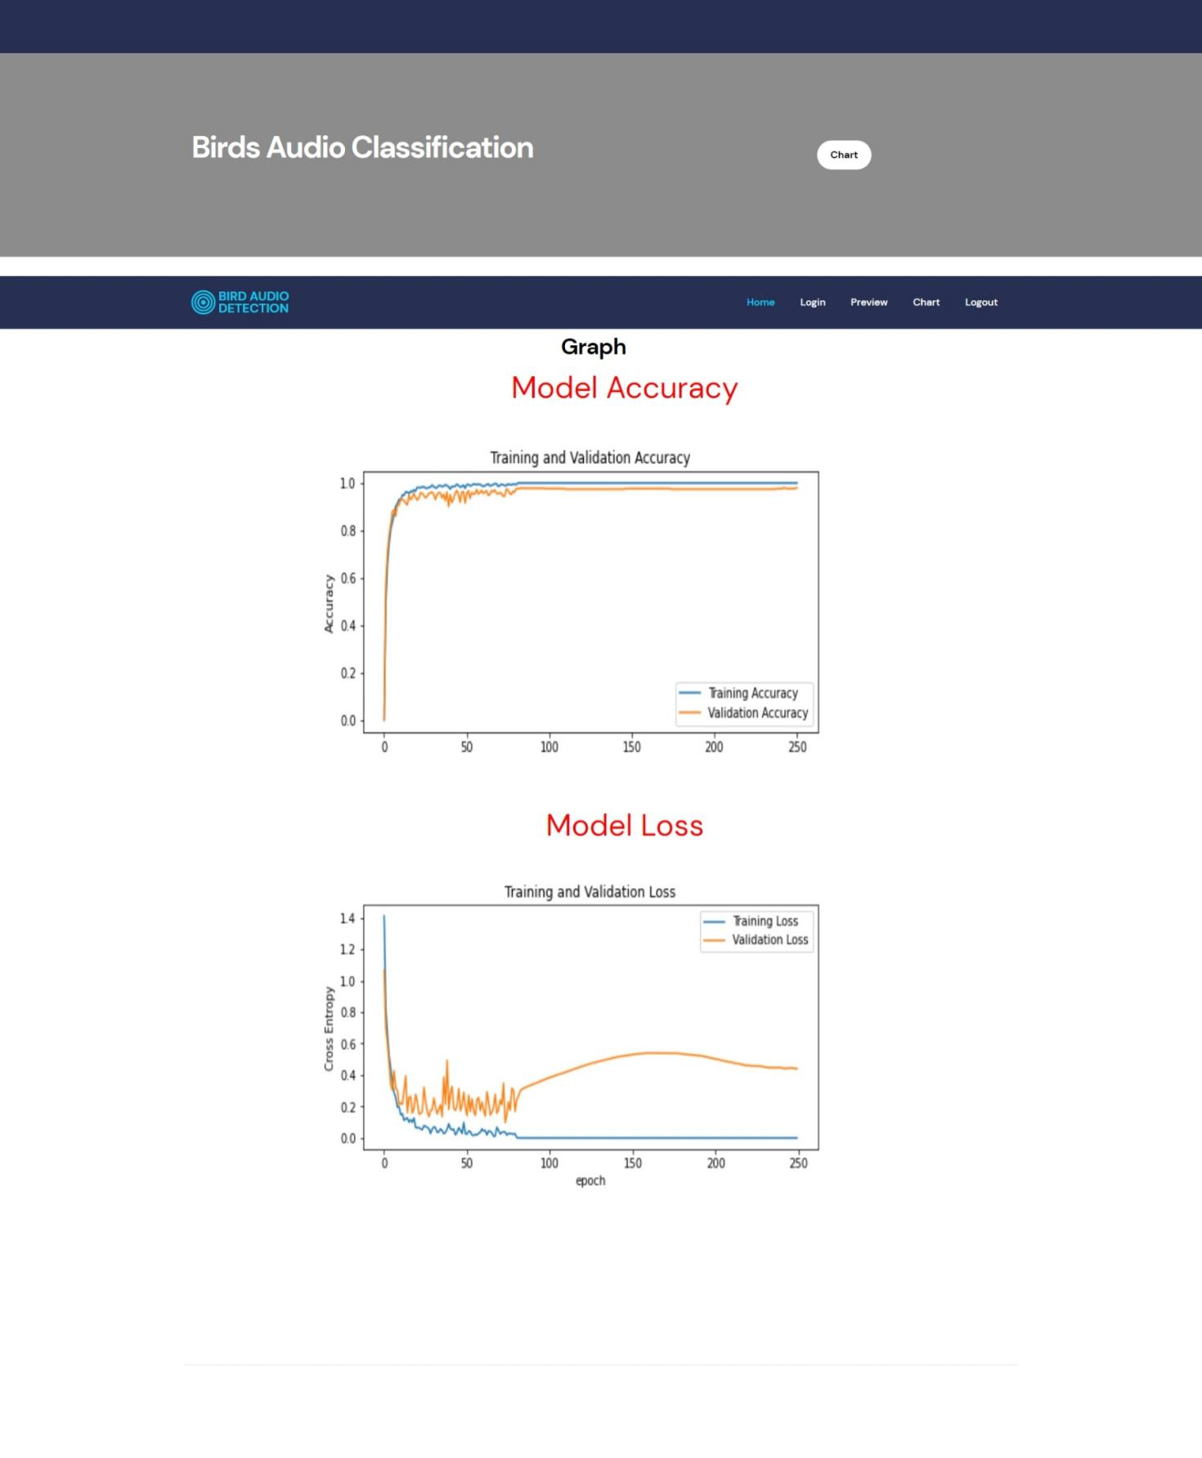

Slide 12
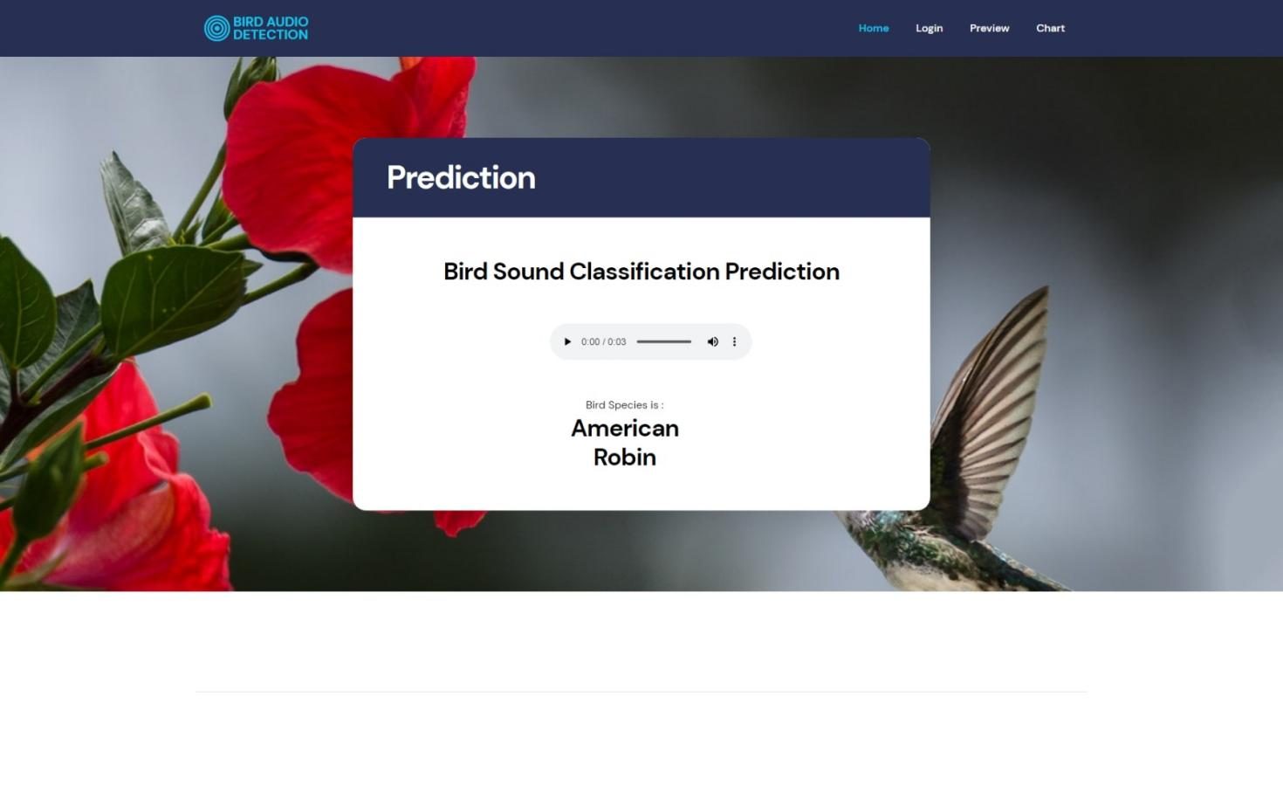
Final output
The waveform of a bird's voice can be obtained using MATLAB software. Dataset can be individually captured in mp3 format, which must be converted to a.wav file, and it is evident that each bird has a distinctive voice. Through a process of training, an ANN is tuned for a specific purpose, such as pattern classification.

Slide 13
09 Conclusion
An artificial neural network (ANN) model was developed for automatic bird species recognition to aid researchers in conducting particular research due to the impact of climate change and the number of endangered species.
The system recognizes bird sounds using ANN and categorizes and identifies bird noises using their distinctive tonality.
The necessary information on the power spectral density of birds is employed to get data for each species of bird and to teach ANN to recognize different bird species.
A graphical user interface (GUI) for bird sound identification has been created, requiring audio input from the user to identify the species of bird.
Future work includes developing an iOS or Android app for user convenience and utilizing cloud computing for greater computational power and data storage.

Slide 14

THANK YOU

